Slide 1

“Bank Customer Churn Prediction”
Using Explainable AI
DBA5102 | Group 21:
Kaushik Asok (A0262739U)
Manan Lohia (A0262838U)
Muthukumaran Samiayyan (A0027474A)
Pragati Sangal (A0262745Y)
Prasanna Govindarajan (A0262732H)

Slide 2
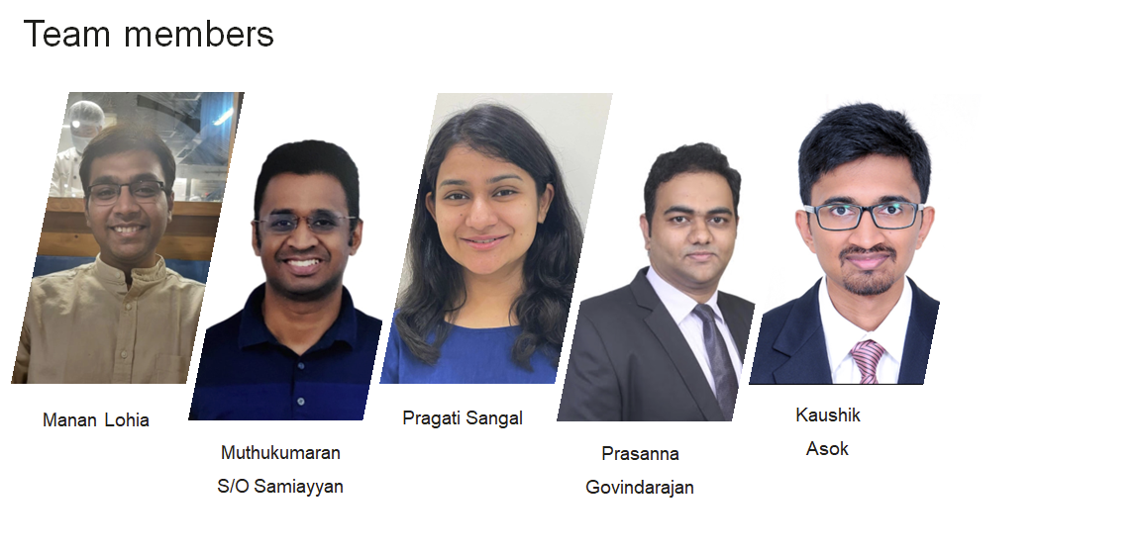

Slide 3
Agenda
Background
Problem Statement
Project Objective
Exploratory Data Analysis
Methodology
Model Results
Model Interpretability
Conclusion

Slide 4




Background: “Why do Bank need customers?”
Primary source of Revenue
Customer Deposits and
Asset - Liability Management
Bank’s reputation and reliability

Slide 5
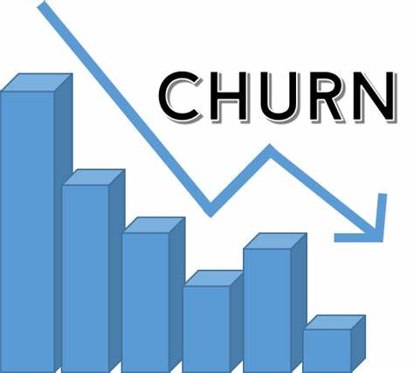
Problem Statement: “Customer Attrition”
High Customer Churn Rate
Difficulty in Predicting Churn Behavior
Inability to Identify At-Risk Customers
Inefficient Use of Resources
Lack of Proactive Retention Strategies

Slide 6
Project Objective
1
Build a machine learning model to predict churn
2
Use Explainable AI techniques to identify the underlying factors for the predictions
3
Develop recommendations and tools focusing on proactive retention strategies, such as improving customer service, reducing fees, or offering targeted incentives to at-risk customers

Slide 7
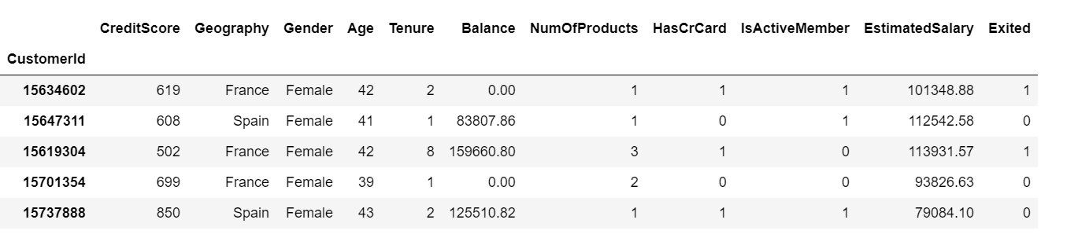
Exploratory Data Analysis
Data is obtained from Kaggle
10,000 customer records
14 independent columns including target variable “Exited”.
Target Variable Exited
0: Retained
1: Exit

Slide 8

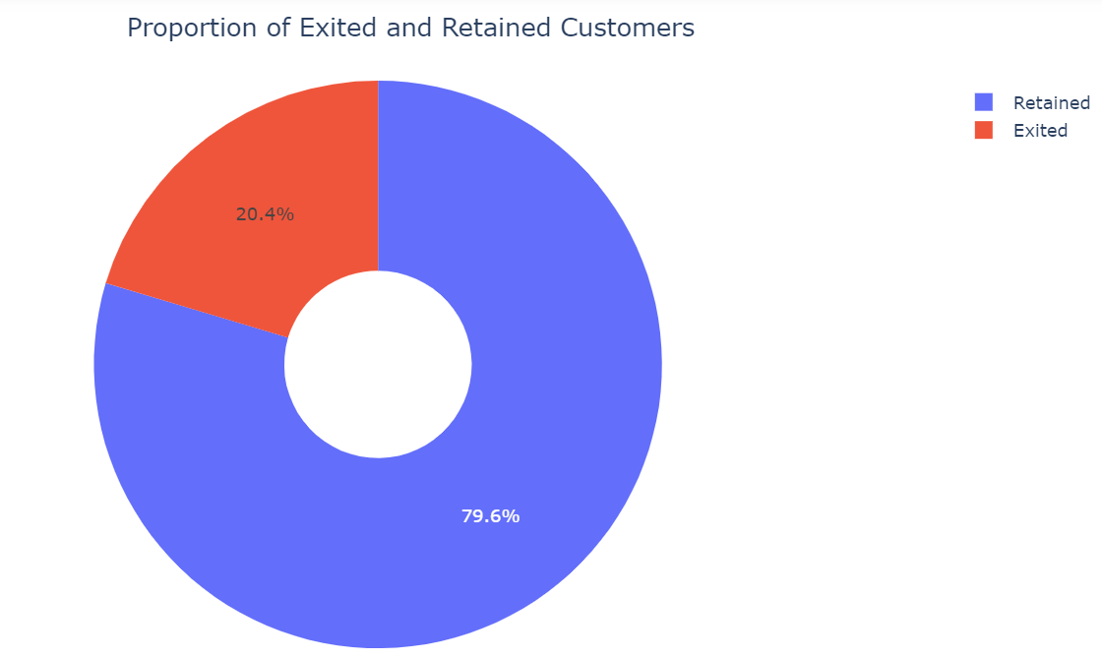
Exploratory Data Analysis
Imbalanced Dataset: 20.4% of customers already left the bank (2040 customers out of 10,000)

Slide 9
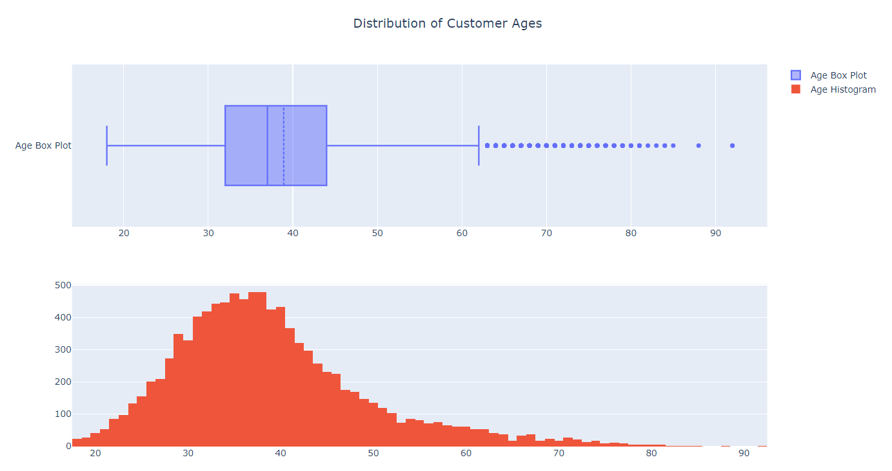
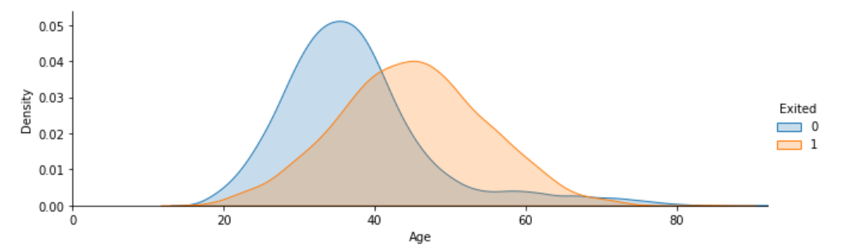
Exploratory Data Analysis
Customer Age Distribution: The median customer age is around 37 years and the age group follows roughly a normal distribution.
The mean age for exited group is higher than the mean age group for non-exited customers

Slide 10
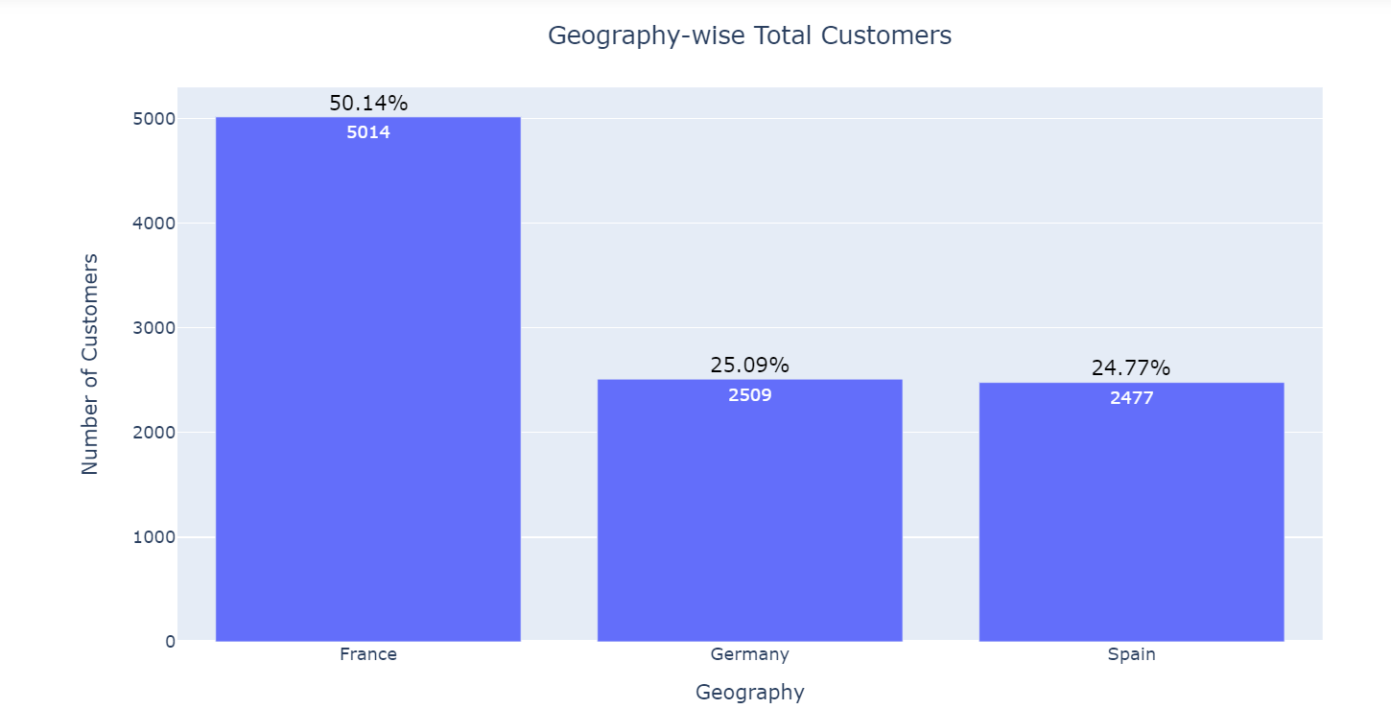
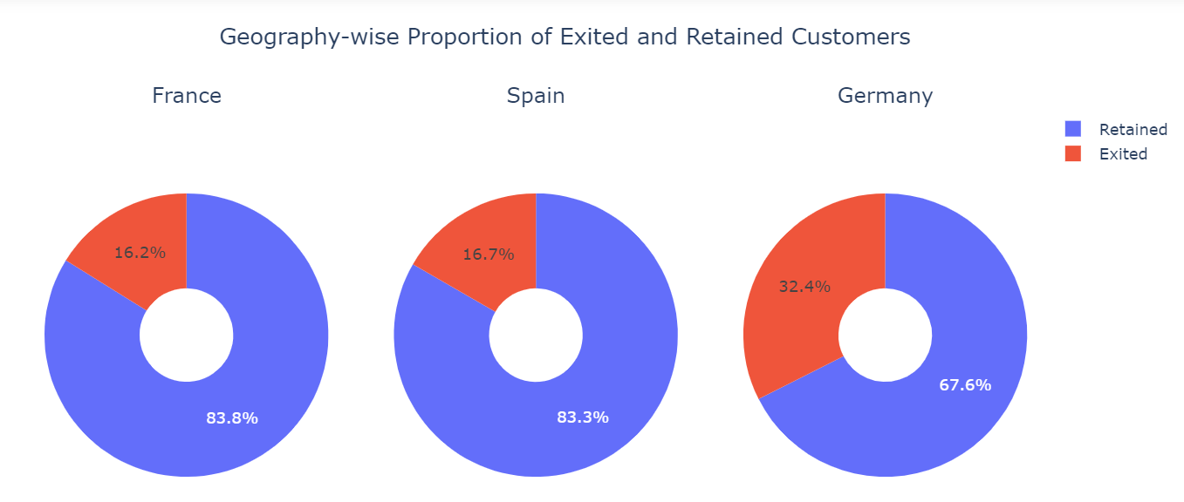
Exploratory Data Analysis
Geography Distribution: While France has highest number of customers, a significantly higher attrition rate is witnessed in Germany. This is possibly on account of service issues or varied market conditions in Germany.

Slide 11
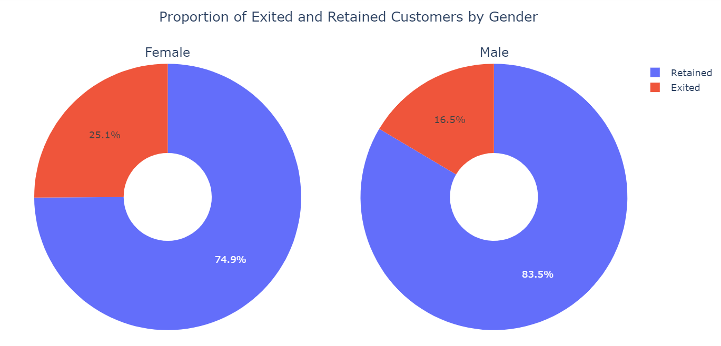
Exploratory Data Analysis
Demographics Distribution: Females have higher attrition rate as compared to males.
A possible hypothesis for this could be that other banks are offering better services / preferential rates targeted at female customers, causing the bank’s female customers to move to a different bank

Slide 12
Methodology
Data Pre-processing & Feature Engineering
Model Building & Evaluation
Train-Test Split and SMOTE
Drop irrelevant columns
Replace 0 with -1 for ‘IsActiveMember’ & “HasCrCard’ fields
Create ratio features
Balance/Salary
Credit Score/given age
Num Products/Salary
One-hot encoding for categorical variables
Standard Scalar for continuous variables
Train Set (80%)
(SMOTE to address class imbalance)
Test Set (20%)
Logistic Regression
SVM with RBF Kernel
Random Forest
XGBoost
Gradient Boosting

Slide 13
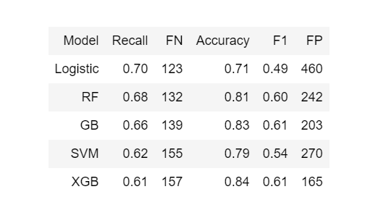
Model Results
Evaluation Metrics - highest Recall of the `Exited` class as we do not wish the model to miss out on potential churn.
Best Model: Logistic Regression (0.70)
Best Selected Model: “Random Forest Model” having Recall (0.68) close to logistic regression with significant lower False Positives (242)

Slide 14
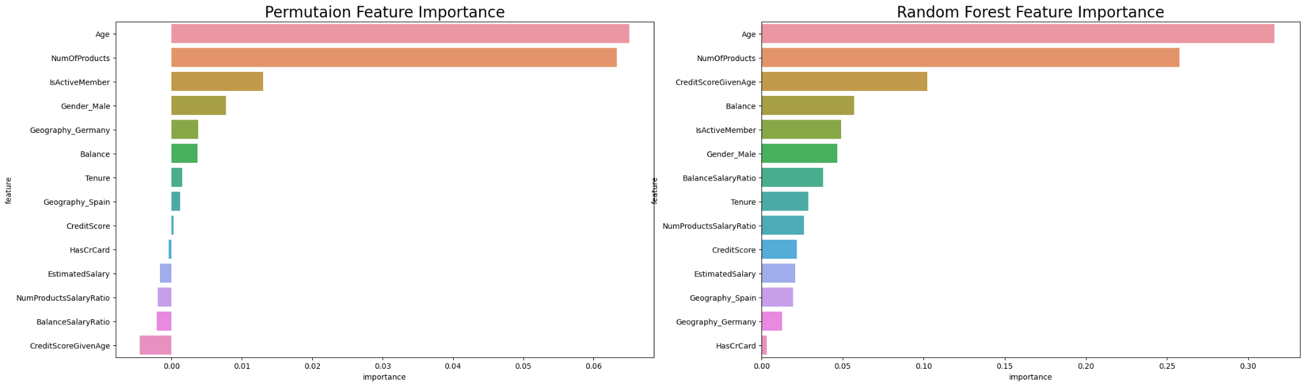
Model Interpretability

Slide 15
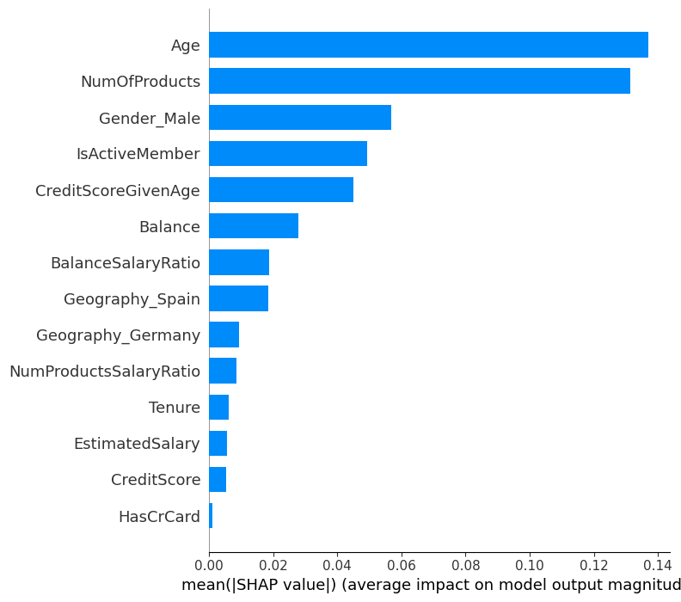
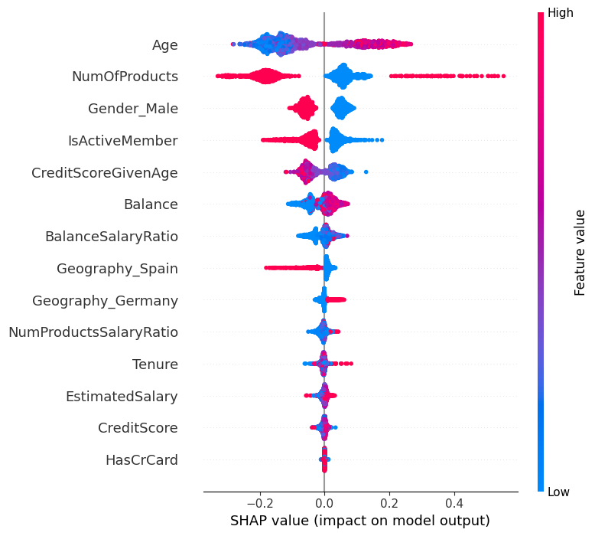
Model Interpretability: Shap Explainer
“Global Explanation”

Slide 16
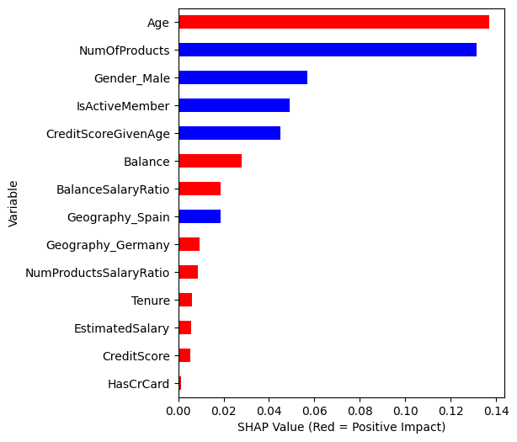
Model Interpretability: Shap Explainer
Top 5 features impacting model prediction
Older customers are more likely to churn
Customers with more products are less likely to churn
Male customers have lower chance of exit compared to female customers.
Active members with higher engagement are less likely to churn
Younger customers with higher credit scores are less likely to churn, possibly due to more product offerings from the bank
Red bars -> Positive correlation, Blue bars -> Negative correlation

Slide 17
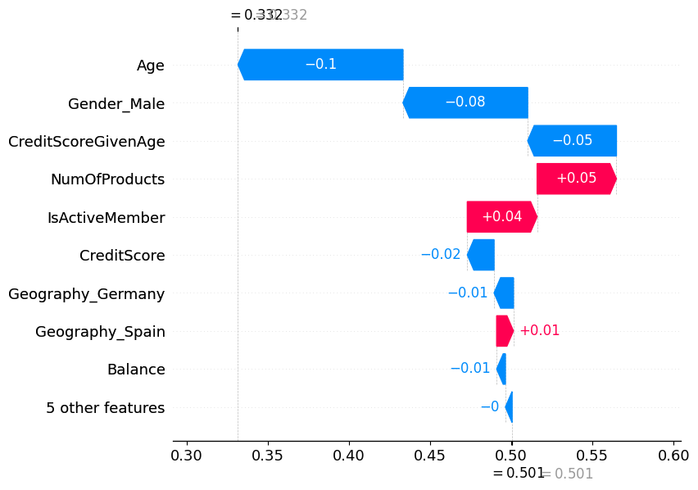
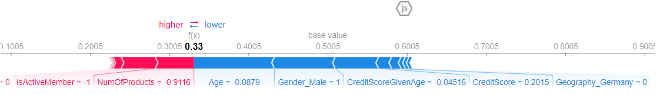
Model Interpretability: Shap Explainer
Shap example of customer ‘Exited’ = 0
Waterfall Model: “Local Explanation”
Shows the contribution of each feature to model output for each single data point
Model Output = 0.332, shifted from the default 0.5 due to the effect of individual features as shown in the plot

Slide 18
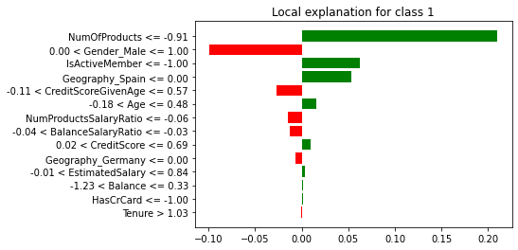
Model Interpretability: LIME Explainer
LIME Example:
Customer (15766649) with ‘Exited’ = 0

Slide 19
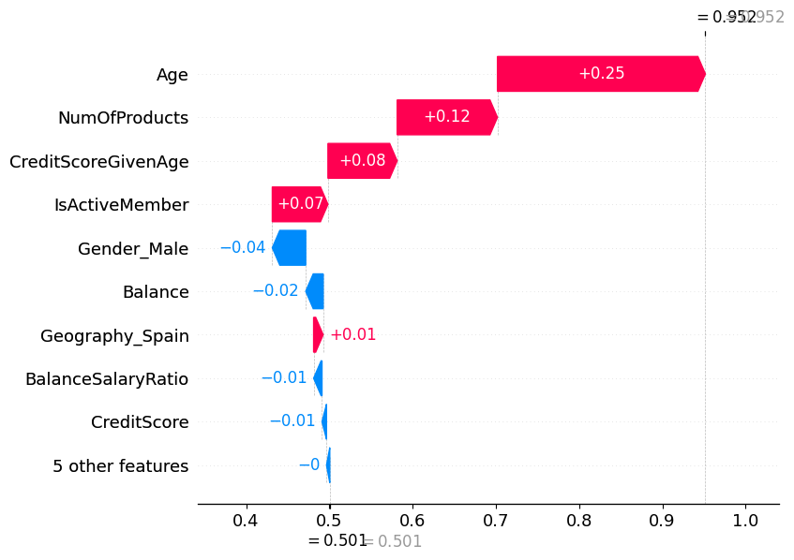
Model Interpretability: Shap Explainer
Shap example for customer ‘Exited’ = 1
Model Output = 0.501, shifted from the default 0.5 due to the effect of individual features as shown in the plot

Slide 20
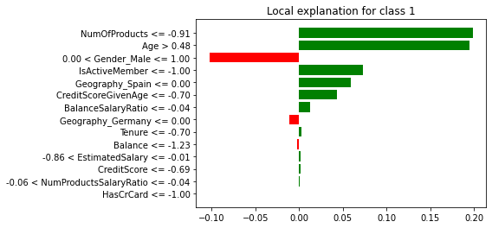
Model Interpretability: LIME Explainer
LIME Example:
Customer (15656683) with ‘Exited’ = 1

Slide 21
Conclusion: Business Improvements
Age: Most important factor affecting churn
Older customer segment show higher exit ratio.
Possibly on account of higher net worth as customers age, they prefer exclusive and customized products.
Bank can look to design customised products targeting older customers
No of products: Second most important factor
(as per SHAP Global explanations as well as the permutation feature importance map)
Banks can target increase in product penetration per customer
Results in stickiness thereby lower probability of exit.
Female customers show a higher churn ratio
Incentivise women customers by offering them preferential pricing / targeted products

Slide 22
Conclusion: Model Usage
While global explanations provide information about overarching trends, and direct organizational strategies for improvement, local explanations can aid in a more targeted execution of said strategies.
Relationship Manager can refer dashboard or report to identify the risk of churn (local explanations of individual customer)
Probability of retention can be increased by identifying the underlying factors for potential exit.
Alert system can be set up wherein model predicts the risk of exit of customer when probability of exit exceeds certain threshold
Local explanations can also explain how to approach the situation based on the most important factors contributing to risk of individual customer

Slide 23
Conclusion: Further Exploration
Amongst the three geographies in the dataset, Germany shows the highest rate of churn, which offers a challenging problem for the bank.
MLI/XAI can be used for a better understanding of segment specific issues
For example, churn within German customers can be explained using XAI models and major reasons for churn can be identified.
Turnaround strategy can be developed based on these inputs and specific issues in the segment can be addressed
A similar approach can also be used to improve bank performance with the female segment

Slide 24
Thank you!

